Slide 1
S-Rating Process Registration
Preface:
Step-by-step guide on acquiring your Sustainability Rating through the Volkswagen Group Supply Platform

Slide 2
Table of Contents
Acquire DUNS Number
Register in ONEKBP
complete S-Rating Survey
01
02
03

Slide 3
Acquiring DUNS Number
01

Slide 4
Acquiring DUNS Number
If your company does not already have a DUNS number, please go to Dun & Bradstreet’s company site for more information: https://www.dnb.com/duns/get-a-duns.html?search

Slide 5
Registering in OneKBP
02

Slide 6
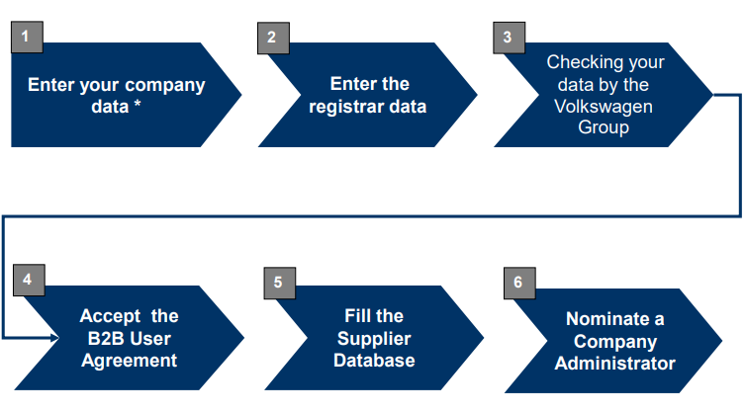
Registering in OneKBP
Overview

Slide 7
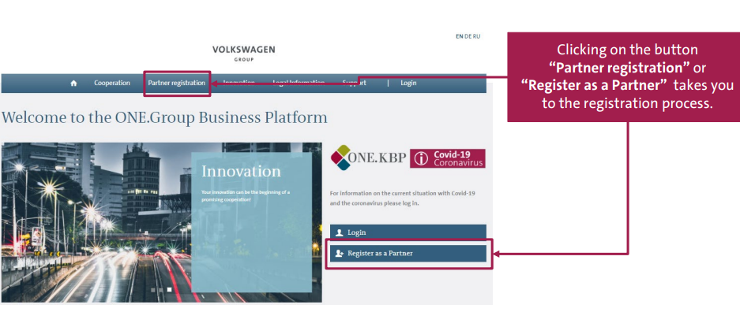
Registering in OneKBP
Go to: vwgroupsupply.com

Slide 8
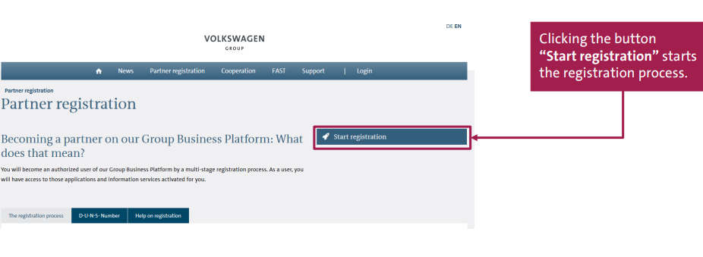
Registering in OneKBP
Starting the Process:

Slide 9
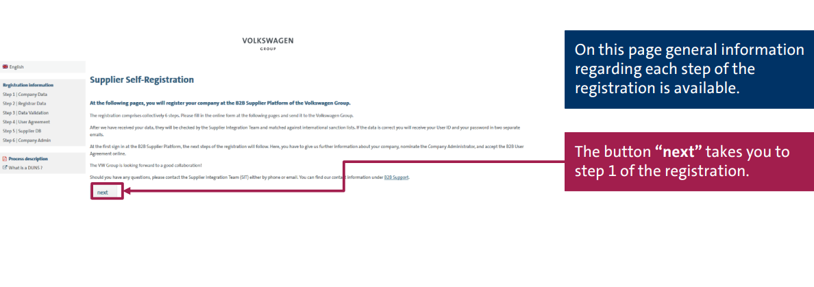
Registering in OneKBP
General Information:

Slide 10
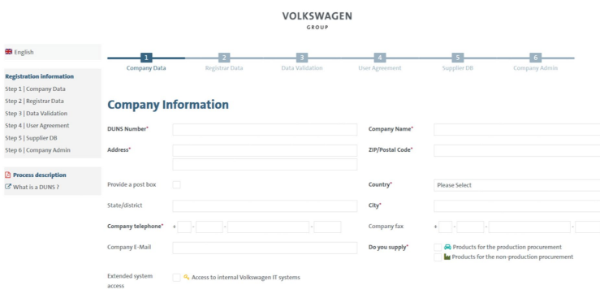
Registering in OneKBP
STEP 1: Company Information

Slide 11
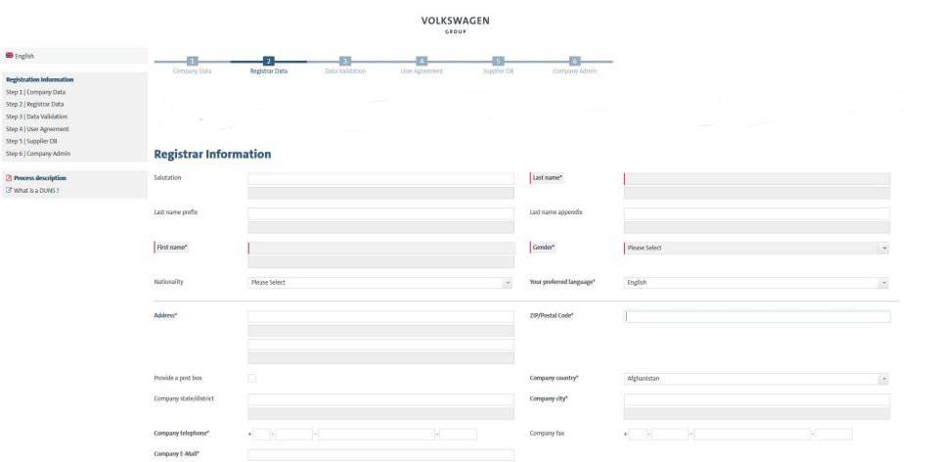
Registering in OneKBP
STEP 2: Registrar Information

Slide 12
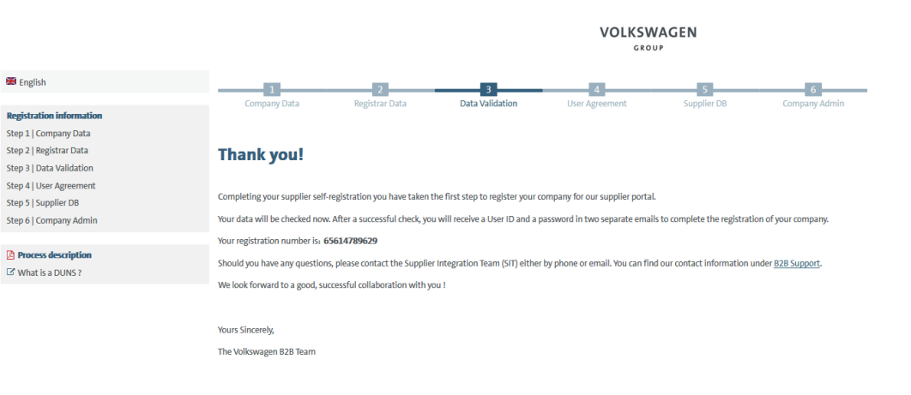
Registering in OneKBP
STEP 3: Data Validation (done by VW)

Slide 13
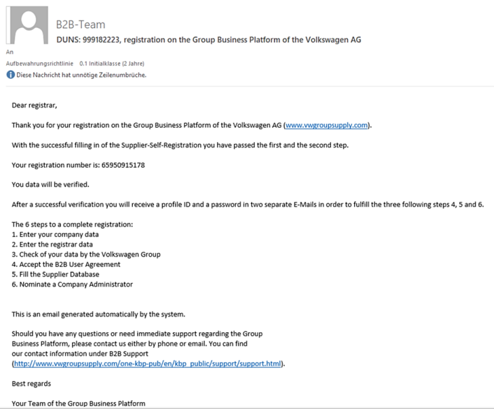
Registering in OneKBP
E-Mail with Registration # will be sent

Slide 14
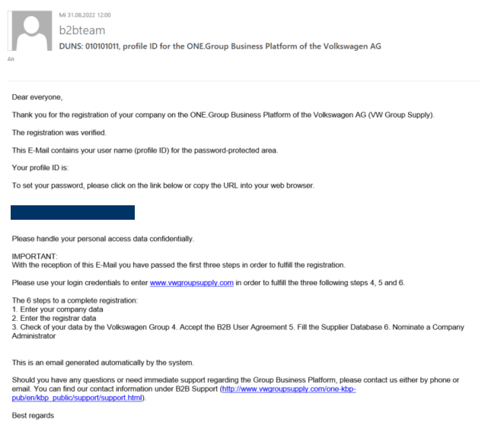
Registering in OneKBP
After validation, Login Credentials will be sent

Slide 15
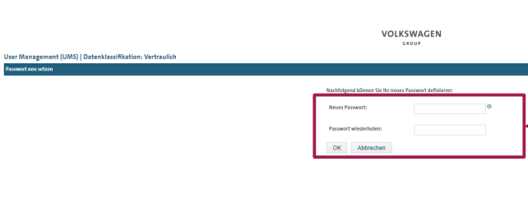
Registering in OneKBP
Create a new Password

Slide 16
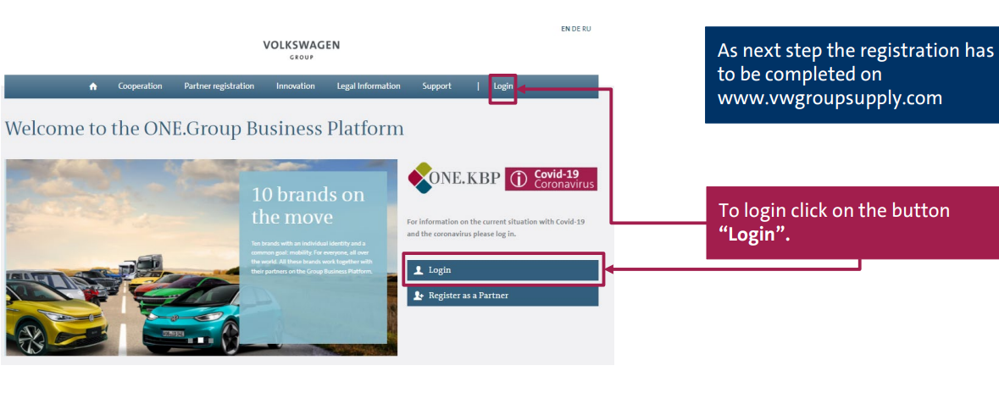
Registering in OneKBP
Login using new credentials

Slide 17
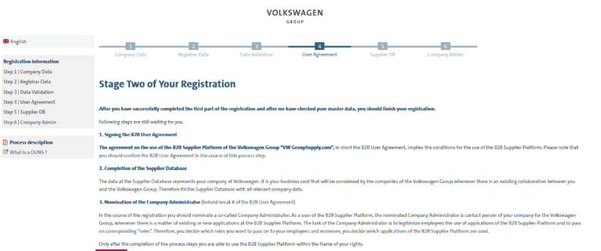
Registering in OneKBP
Begin Stage 2 of the Registration

Slide 18
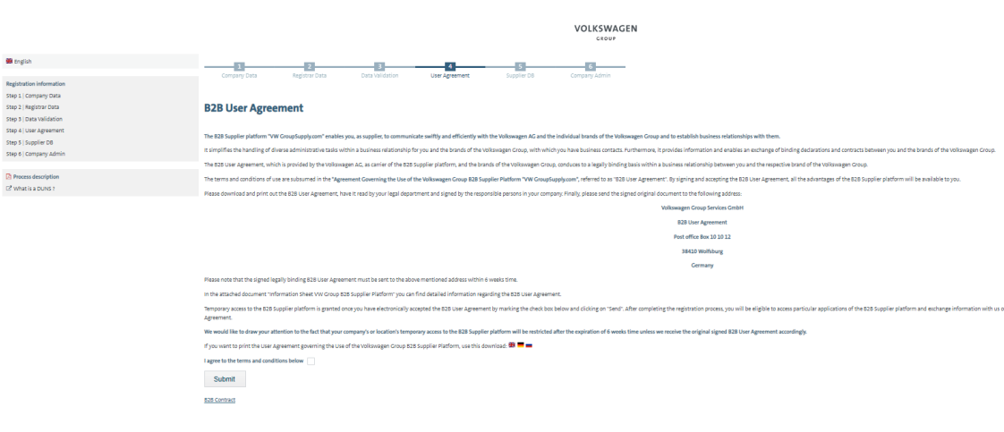
Registering in OneKBP
STEP 4: Agree to the B2B User Agreement and download a hard copy

Slide 19
Registering in OneKBP
The B2B User agreement should be printed out, signed and sent by post to the given address
Only the original copy should will be considered for approval
For further questions or issues:
E-Mail: b2bteam@vwgroupsupply.com
Phone Number: +52 (222) 230-9386
US Phone (toll free): (833) 448-9748

Slide 20
Registering in OneKBP
STEP 5: Filling out the Supplier Database

Slide 21
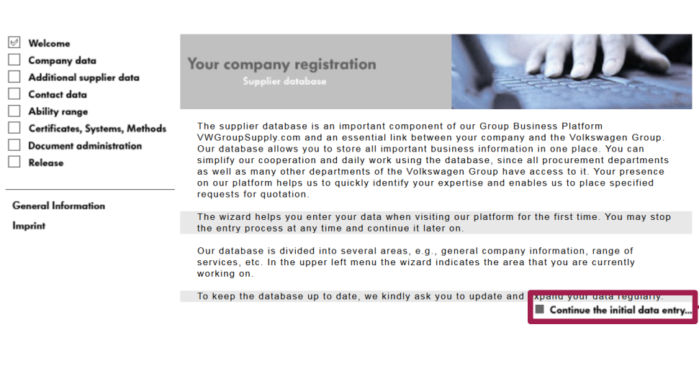
Registering in OneKBP
Complete all sections from the left menu

Slide 22
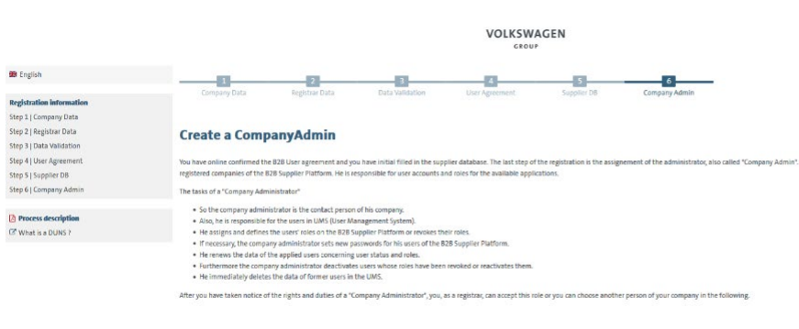
Registering in OneKBP
STEP 6: Create a Company Admin

Slide 23
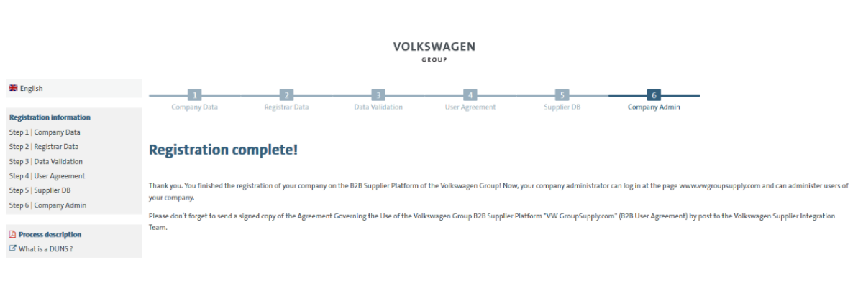
Registering in OneKBP
Registration complete ✓

Slide 24
Completing S-Rating Survey
03

Slide 25
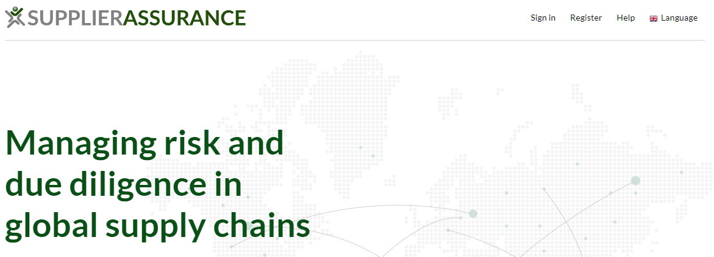
Completing S-Rating Survey
Go to: https://supplierassurance.com/
Click Register

Slide 26
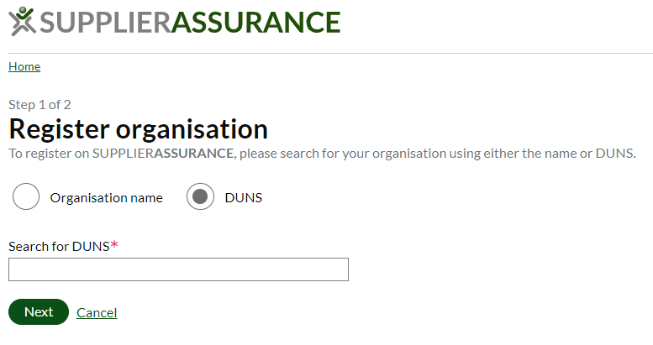
Completing S-Rating Survey
Register using your DUNS

Slide 27
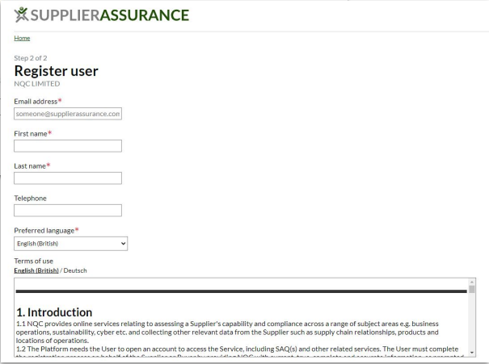
Completing S-Rating Survey
Complete Registration

Slide 28
Completing S-Rating Survey
Contact Information

Slide 29
Completing S-Rating Survey
About our Sustainability Rating (S-Rating)
Purpose is to assess our suppliers’ sustainability performances.
Determined by your score in the Sustainability Self-Assessment Questionnaire (SAQ).
On-Site Checks may be necessary at your site.
Please note, the rating is valid for sites with a headcount of 10 or more.
Company sites with less than 10 employees can get an exception from the S-Rating.

Slide 30
Completing S-Rating Survey
About the SAQ
The Self-Assessment Questionnaire (SAQ) is the basis for the S-Rating.
It covers questions in the areas of human rights and working conditions, environment, business ethics, supplier management as well as the responsible sourcing of raw materials.

Slide 31
Completing S-Rating Survey
Achieving a Positive S-Rating (9 or less employees)
Company sites with ≥9 employees can apply for an exception from the S-Rating.
Send an email to: sustainability@vwgroupsupply.com

Slide 32
Completing S-Rating Survey
Achieving a Positive S-Rating (10-99 employees)
Complete the Self-Assessment Questionnaire (SAQ) on the Supplier Assurance Platform
Make sure that all VW minimum requirements are met
In case one policy (or several) does not yet exist, please create an according document
If all minimum requirements are fulfilled, you will reach a positive S-Rating for your location
Minimum requirements Score of 80% or higher

Slide 33
Completing S-Rating Survey
Achieving a Positive S-Rating (100 or more employees)
Complete the Self-Assessment Questionnaire (SAQ) on the Supplier Assurance Platform
Make sure that all VW minimum requirements are met
In case one policy (or several) does not yet exist, please create an according document
If you comply with all minimum requirements and obtain a SAQ score of 80% or more, you reach a green S-Rating

Slide 34
Completing S-Rating Survey
Achieving a Positive S-Rating (100 or more employees)
If you reach a SAQ score of less than 80%, the S-Rating depends on further factors. First, make sure you have met the minimum requirements of the Volkswagen Group. Following that, work on the questions concerning management systems to improve your score.
In addition, locations with own production sites should be aware that they need to prove a certified environmental management system

Slide 35
Completing S-Rating Survey
S-Rating Contact
Questions regarding:
Exemption from the S-Rating
Minimum requirements
Scoring
E-Mail: sustainability@vwgroupsupply.com

Slide 36
Thank You

